Slide 1

Introduction to Network Security
Deep Ramanayake

Slide 2
Objectives
Identify common vulnerabilities to networks
Explain the goals of network security
Discuss the best approach to network security when designing a secure network
Explain network security defenses and sample project outline

Slide 3
Common Threats to Network Security
Data Theft
Malware Attacks
Inside Intrusions
Social Engineering
Notes:
Motivation of attackers
Status
Revenge
Financial gain
Industrial espionage
Principle

Slide 4
Common Network Security Vulnerabilities
Design Flaws in Operating Systems and Networks
Human Vulnerabilities
Process Vulnerabilities

Slide 5
Basic Network Structure
Networks are designed for communication.
Physical network structure includes switches, routers, firewalls, etc..
Also make sure to you clearly understand of the following:
Data packers, five tuple, OSI model .
Basic Network Utilities
Notes:
The fundamental purpose of networks is for communication
Part of the network structure includes:
NICs, hubs, switches, routers, and firewalls
Network architecture comprises the format in which these devices are connected

Slide 6
What we need to protect
Data
People
Network Devices and connection points

Slide 7
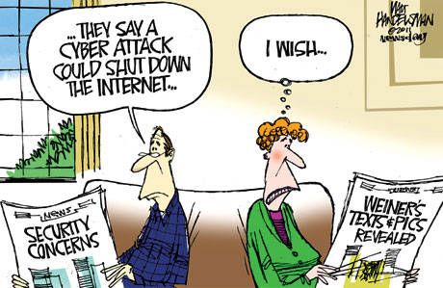
Understand the Threats to the Network
How likely are attacks on your systems?
No real threat
Everyone is after me

Slide 8
Types of Attackers
Hacktivists
Organized Crime
Script Kiddies
Nation-State Actors
Inside Actors
Advanced persistent threat groups

Slide 9

Goals of network security
Integrity
Confidentiality
Availability
Network Security

Slide 10
Goals of Network Security (Cont.)
Providing secure network connectivity
Secure connectivity with trusted users and networks (Ex. VPN)
Use layered security scheme (Combination of multiple security standards)
Practice least privilege
Provide Encryption to:
Protect integrity, confidentiality, and authentication of digital information and prove nonrepudiation
Physical security
Educate employees about security dangers and policies

Slide 11
Goals of Network Security (cont.)
Network Segmentation
Creating security zones
DMZ, Internal and External
Use VLan
Separate departments based on roles.
Proactive Versus Reactive
Monitor Network activities.
Look for unknowns/anomalies.
Backup and encryption

Slide 12

Using Network Defense Technologies
Password security
Authentication methods
Antivirus protection
Firewalls
Packet filtering
Intrusion detection systems
Network auditing and log files
Information Hiding
Design Simplicity

Slide 13
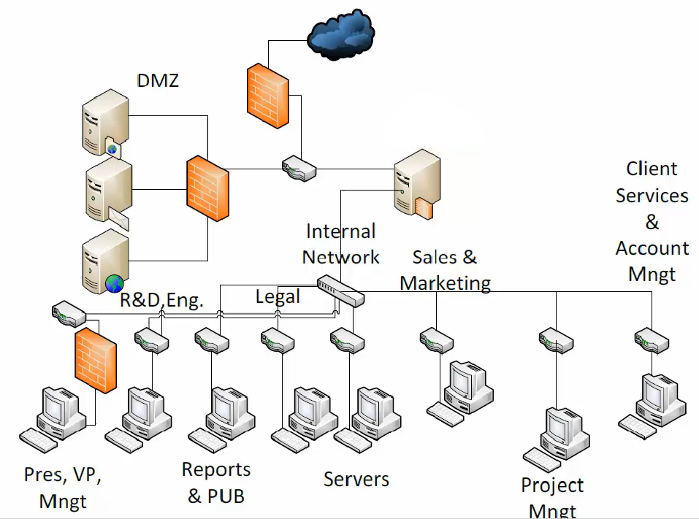

Slide 14
Network Security and the Law
Sarbanes-Oxley (SOX)
Computer Security Act of 1987
Health Insurance Portability and Accountability Act (HIPAA)

Slide 15
The Impact of Defense
Cost of security breach are very high in terms of return on investment (ROI).
Get management support to ensure comprehensive security scheme.
Discuss funding, staff, downtime, and resources for entire span of project.
Security systems must be continuously maintained and updated.

Slide 16
Web Resources
https://www.us-cert.gov/ The Computer Emergency Response Team site; a respected security resource
http://www.microsoft.com/en-us/security/default.aspx The Microsoft Security Advisor website, with Microsoft-specific security information
https://www.sans.org/security-resources/glossary-of-terms/ SANS Glossary of Security Terms
http://www.247.prenhall.com Pearson product support

